Slide 1
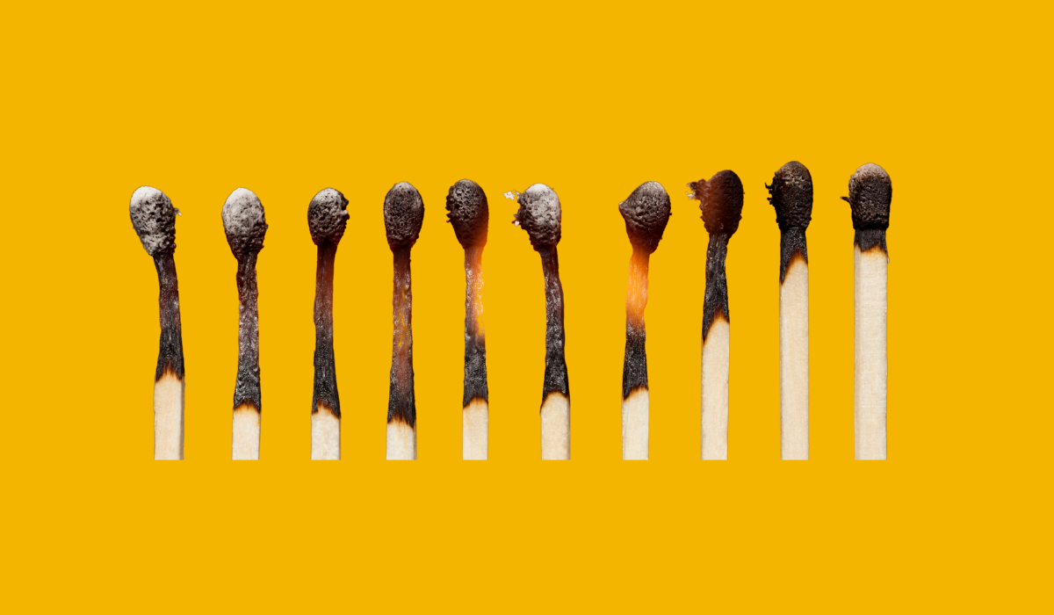

Slide 2
“Death by a thousand paper cuts”
Negative experiences pile up because difficult days follow difficult days. The consequence is health suffers, decision making capacity declines, and we become less effective in our roles =
Burn Out
This Photo by Unknown Author is licensed under CC BY

Slide 3
VUCA World
Volatility
Uncertainty
Complexity
Ambiguity

Slide 4
Stress and Emotional
Resilience Cycle

Slide 5
The Behavior Chain
Trigger
Thought
Action
Consequence

Slide 6
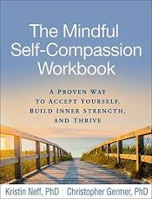
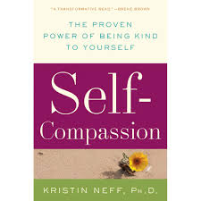
Dr. Kristin Neff Self-compassion

Slide 7
Benefits of self-compassion
Happiness
Life satisfaction
Self-confidence
Physical health
Depression
Anxiety
Stress
Shame

Slide 8
Healthy Unhealthy
Self-kindness Self-judgment
Common Humanity Isolation
Mindfulness Over-identification

Slide 9
Awe and wonder
Experiences of awe and wonder help us feel connected to something bigger and more important than ourselves and make us more altruistic, generous, and compassionate.
Research by Rudd, Vohs, and Aaker, referenced in Flourishing in Ministry: How to Cultivate Clergy Wellbeing
Awe and wonder are powerfully uplifting and can help people overcome challenges and difficulties in life. Pg. 5
“And he went away wondering to himself what had happened” (Luke24:12b).

