Slide 1


MINNESOTA PAID LEAVE WEBINAR
Minneapolis Area Synod of the ELCA
November 20, 2025

Slide 2

AGENDA
Eligibility
Benefits
Employer Responsibilities
Other Information
Examples
Questions

Slide 3
MINNESOTA PAID LEAVE
ELIGIBILITY

Slide 4
COVERED EMPLOYEE
Worked 50% or more of the prior year in Minnesota (for employees who did not work 50% or more of the year in any one state, who live in Minnesota), and
Earned at least 5.3% of the statewide average annual wage in the past year ($3,900)
Remote workers who earned at least $3,900 and work at least 50% of the time from a location in Minnesota are covered
Employee receiving payments from unemployment insurance, workers compensation, or Social Security disability during an absence are not eligible

Slide 5
OTHER WORKERS
Workers not covered who can opt into Paid Leave by setting up their own account with the state:
  Independent contractors
  Self-employed workers (including pastors who pay SECA instead of FICA- even if they receive a W-2 from the church)

Slide 6
MINNESOTA PAID LEAVE
BENEFITS

Slide 7
PARTIAL WAGE REPLACEMENT
  Up to 12 weeks of paid MEDICAL leave
  Up to 12 weeks of paid FAMILY leave
  No more than 20 weeks of Paid Leave in a benefit year
  At least 480 hours of Paid Leave can be intermittent
  Amount of Paid Leave weekly wages replaced:
Weekly Wage | % of Weekly Wage Received
Up to $711.50 | 90%
Between $711.50 - $1,423 | 66%
Above $1,423 | 55%

Slide 8
JOB PROTECTION
When returning from leave, employees must be restored to the same or an equivalent position with the same pay and benefits as before leave
Job protection begins 90 days from an employee’s date of hire

Slide 9
MINNESOTA PAID LEAVE
EMPLOYER RESPONSIBILITIES

Slide 10
REPORTING AND PREMIUM PAYMENTS
  Report wages as required through the unemployment insurance (UI) reporting system
  Are you going to split premiums with employees? (Start deducting premiums from paychecks 1/1/26)
    2026 premium = .88% of employees’ wages up to Social Security cap ($176,100 in 2025)
    Small employers (30 or fewer employees) - reduced employer premium of .22% (.66% total premium instead of .88%)
    Employers can deduct up to .44% from employees’ pay
  First quarterly premium due by April 30, 2026

Slide 11
LEAVE ADMINISTRATION
  Designate Paid Leave administrator(s) with state
  Work with payroll provider to understand who does what
  Coordinate Paid Leave with the organization’s paid time off benefits; decide whether to permit supplemental payments to “top off” Paid Leave payments (employees never receive more than 100% of wages)
  Establish intermittent leave policy and paid leave policy, including process for employees to notify the organization they are applying for Paid Leave
  Ensure all leaves run concurrently (at the same time)

Slide 12
REQUIRED NOTICES
  By December 1, 2025:
  Written notification to each employees about Paid Leave rights and benefits in their primary language; obtain and keep acknowledgment
  Display workplace poster in English and in any language spoken by 5 or more employees
  Model poster and sample notification on Paid Leave website
Going forward, notify new employees of Paid Leave rights and benefits within 30 days of hire

Slide 13
MINNESOTA PAID LEAVE
OTHER INFORMATION

Slide 14
SMALL EMPLOYER ASSISTANCE
Small employer = employs 30 or fewer employees that make an average weekly wage of less than 150% of statewide average weekly wage ($2,134.50 in 2025)
Grants of up to $6,000 available beginning January 1, 2026 to help offset the cost of hiring temporary workers or increase current employees’ wages to cover for employees on Paid Leave

Slide 15
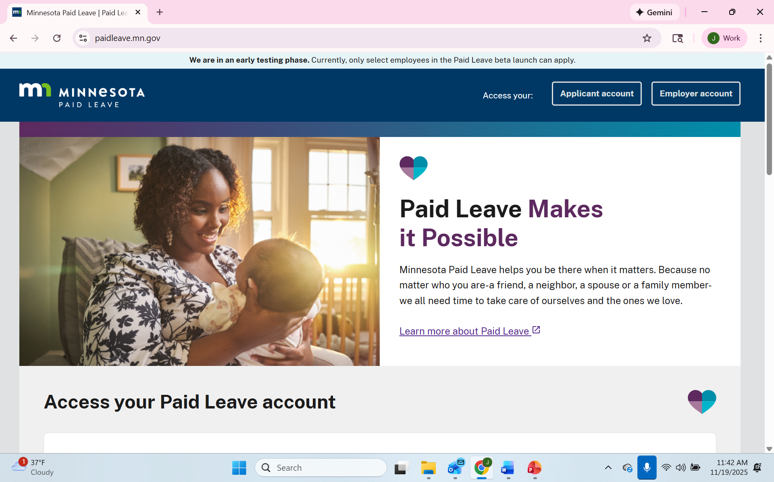
PAID LEAVE RESOURCES
Minnesota Paid Leave website: https://paidleave.mn.gov/
Premium calculators, administrator registration, model notices and poster, FAQs, etc.

Slide 16
EXAMPLES

Slide 17
 | Minnesota Paid Leave | Earned Sick/Safe Time | Vacation | Sick | Parental Leave | Short Term Disability
Benefit | Medical - up to 12 weeks partial pay Family - Up to 12 weeks partial pay Max – 20 weeks/year | Accrue 1 hour for every 30 hours worked; up to 48 hours each year; maximum accrual of 80 hours | See policy- Assume accrual of 2 days/month Can use as soon as accrued | See policy – Assume accrual of 1 day/month Can use as soon as accrued | See policy – Assume up to 6 weeks of regular pay for childbirth, bonding with new child | See policy – assume 2 month waiting period Up to 4 months at 66% of pay
Flu for 4 days | N/A | 32 hours of ESST | Use 4 days | Use 4 days | N/A | N/A
Surgery and recovery – 6 weeks | State should approve 6 weeks of partial pay | N/A | Supplement partial pay from state | Supplement partial pay from state | N/A | N/A
Bonding with new child – 8 weeks | State should approve 8 weeks of partial pay | N/A | Supplement pay for 2 weeks after paid parental leave runs out | N/A | Supplements partial pay from state for 6 weeks | N/A

Slide 18
 | Minnesota Paid Leave | Earned Sick/Safe Time | Vacation | Sick | Parental Leave | Short Term Disability
Benefit | Medical - up to 12 weeks partial pay Family - Up to 12 weeks partial pay Max – 20 weeks/year | Accrue 1 hour for every 30 hours worked; up to 48 hours each year; maximum accrual of 80 hours | See policy- Assume accrual of 2 days/month Can use as soon as accrued | See policy – Assume accrual of 1 day/month Can use as soon as accrued | See policy – Assume up to 6 weeks of regular pay for childbirth, bonding with new child | See policy – assume 2 month waiting period Up to 4 months at 66% of pay
Birth of child – 8 weeks | State should approve 8 weeks of partial pay | N/A | Supplement pay for 2 weeks after parental leave runs out | Supplement pay for 2 weeks after parental leave runs out? | Supplements partial pay from state for 6 weeks | N/A
Lengthy illness – out 4 months (16 weeks) | State should approve 12 weeks of partial pay | N/A | Supplement pay after state and short term disability payments | Supplement pay after state and short term disability payments | N/A | Supplement state partial pay (up to 66% of wages) in month 3; then pays 66% of wages for remaining month

Slide 19
QUESTIONS??

Slide 20
THANK YOU!
jewelie@jgrapelaw.com
651.633.1717

