Slide 1
ELCA Minneapolis Area Synod Tool Kit Leadership Through Loss and the Promise of Change
Rev. Jim Weckwerth and Kristin Wiersma,
The Joshua Group Consultants

Slide 2
Kristin Wiersma
14 years of consulting experience
M.A. Organization Development & Change
Rev. Jim Weckwerth
Consultant for 6 years
ELCA Pastor for 16 years
Trained Interim/Transition Specialist
M.A. Teaching
Professional Development Certificate in Organizational Development (May 2022)

Slide 3
Why We’re Here
To equip you with tools to lead your congregation through times of profound change and transition.
To name and acknowledge that the work of leadership through transition is very hard and the challenges are great.
To equip you to provide God’s promised peace and stability in times that are chaotic and unstable.
To help you proclaim Christ’s promise that the Lenten journey of change and transformation ahead of us leads to the freedom of new life and fulfilled purpose.

Slide 4
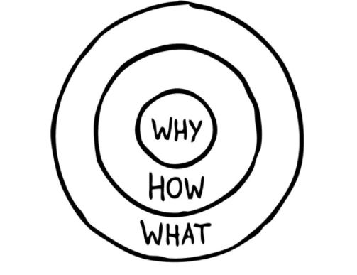
Start With Why

Slide 5
Questions for Leaders
Is there agreement on the why?
If not, what behaviors or symptoms indicate that your congregation is not in alignment with the why?
What freedom do you see in greater clarity of mission, values and vision? For you? Staff? Congregation? Council?

Slide 6
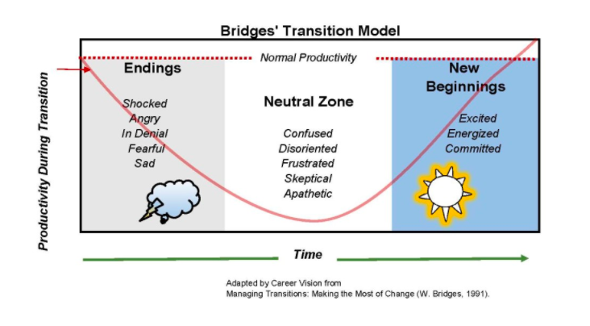
Managing Transitions: 3 Phases
Notes:
Clarity about your congregation’s why is critical for leadership through transitions. Times of significant change and transition are accompanied by significant instability. And your congregation’s why might be the only source of stability that a congregation can rely on as you work through transitions. I am going to walk through this transition model as a framework for leadership and it is important that in every step of the way , leaders connect the transition to your why/mission/holy purpose.

Slide 7
Phase 1: Letting Go
All changes, even the most longed for, have their melancholy; for what we leave behind is part of ourselves; we must die to one life before we can enter into another.
-Anatole France, French writer

Slide 8
Phase 1: Letting Go
Experience: An Emotional Response
Shock
Fear
Resistance
Sabotage
Blame
Skepticism
…and Grief:
Anger
Bargaining
Anxiety
Sadness
Disorientation
Depression

Slide 9
Phase 2: Neutral Zone
It’s not so much that we’re afraid of change or so in love with the old ways, but it’s that place in between that we fear. It’s like being between trapezes. It’s Linus when his blanket is in the dryer. There’s nothing to hold on to.
-Marilyn Ferguson, American Futurist

Slide 10
Phase 2: Neutral Zone
Experience:
A messy in-between time when we let go of what was but have not quite figured out what’s next.
Sense of instability, chaos, lack of movement & direction
Motivation falls and participation decreases
Unresolved anxieties re-emerge and weaknesses are accentuated
Polarization: some ready to move forward; some cling to past

Slide 11
Phase 2: Neutral Zone
…AND Creativity:
The lack of answers and inconsistent structures and routines can create fertile ground for:
New ideas
New questions
Innovation
Experimentation

Slide 12
Phase 3: New Beginnings
The world doesn’t fear a new idea. It can pigeon-hole any idea. But it can’t pigeon-hole a real new experience.”
– D.H. Lawrence, British Novelist
Notes:
You can’t schedule new beginnings

Slide 13
Phase 3: New Beginnings
Experience:
The New Beginning emerges only after people:
Have journeyed through the wilderness (the neutral zone)
Experience some success via the new way
See themselves as new people
You’ll know you’re getting there when you notice:
The new identity is adopted
New sense of purpose is adopted
New sense of energy
Notes:
You’ll know you’re getting there when you start to see people adopting the new identity and sense of purpose

Slide 14
Reflect
Silence for 2 minutes
Place yourself on the transition map.
Place your congregation on the transition map.

Slide 15
Leadership for Healthy Transitions

Slide 16
Small Group Discussion
Leadership for Healthy Transitions
Name the leadership gifts and talents needed to lead your congregation forward from where you placed them on the map.
How might these models (the “Why” and “Transitions”) provide hope and encouragement?

Slide 17
…the Promise of Change: It’s Worth It!
French Priest/Philosopher Pierre Teilhard de Chardin:
Above all, trust in the slow work of God…Only God could say what this new spirit gradually forming within you will be. Give Our Lord the benefit of believing that his hand is leading you. And accept the anxiety of feeling yourself in suspense and incomplete.
Isaiah 43:18-21
¹⁸Do not remember the former things, or consider the things of old. ¹⁹I am about to do a new thing; now it springs forth, do you not perceive it? I will make a way in the wilderness and rivers in the desert. ²⁰The wild animals will honor me, the jackals and the ostriches; for I give water in the wilderness, rivers in the desert, to give drink to my chosen people, ²¹the people whom I formed for myself so that they might declare my praise.
Revelation 21:1-4
21Then I saw a new heaven and a new earth; for the first heaven and the first earth had passed away, and the sea was no more. ²And I saw the holy city, the new Jerusalem, coming down out of heaven from God, prepared as a bride adorned for her husband. ³And I heard a loud voice from the throne saying, “See, the home of God is among mortals. He will dwell with them as their God; they will be his peoples, and God himself will be with them; ⁴he will wipe every tear from their eyes. Death will be no more; mourning and crying and pain will be no more, for the first things have passed away.”

Slide 18
Resources
The Joshua Group. Fulfilling Purpose | www.thejoshua-group.com. | 651- 289-3207
Strategic Visioning and Planning
Organizational Assessment
Leadership Development
Navigating Congregational Change
Retreats, Workshops, Training, Coach
Kairos and Associates. Inspiring Generosity | www.kairosandassociates.com | 651-289-3207
Stewardship Campaigns
Capital Appeals
Listening Phase for Resource Capacity Assessment
Workshops and Webinars
Bridges, William & Bridges, Susan. (2016). Managing Transitions: Making the Most of Change, Boston, MA: Da Capo Press
Sinek, Simon. (2011). Start with Why: How Great Leaders Inspire Everyone to Take Action, New York, NY: Portfolio
Weckwerth, Jim | jim@thejoshua-group.com | 651-270-8394
Wiersma, Kristin | Kristin@thejoshua-group.com | 651-815-1516

