Slide 1
The Minnesota Paid Leave Law: Guidance for Congregations
Minneapolis Area Synod
November 2025
Sarah Crippen, Best & Flanagan LLP
scrippen@bestlaw.com

Slide 2
Minnesota Paid Leave Law
Effective January 1, 2026
Significantly expands leaves available to Minnesota employees
Employees eligible from Day 1 of employment
Program is funded by payroll tax, which employers may split with employees

Slide 3
Coverage

Slide 4
Coverage: Congregations Generally
Congregations are covered employers, even though not covered by unemployment laws
Congregations should register as “Paid Leave Only” employers on the MN DEED Website

Slide 5
Coverage: Lay and Ministerial Employees
Lay staff are entitled to leave under the new law
Pastors are more complicated question
Considered as “employees” for purposes of income tax withholdings
Considered “self-employed” for purposes of FICA (social security, Medicare)
May have to opt in as self-employed individuals, in which case the pastor will pay premiums to the state directly

Slide 6
Funding: Payroll Tax

Slide 7
Payroll tax impact
Beginning effective January 1, 2026, employers with no Equivalent Plan will make quarterly payments of a fixed percentage of their payroll, depending on size
< 30 employees: 66%
> 30 employees: rate is .88%
A premium calculator is available to estimate your expense for this tax.
Employers may require employees to contribute to this premium/tax, through withholdings similar to health insurance premiums
Generally, up to ½ of the premiums paid, depending on size of employer
The tax rate will be adjusted for each calendar year, but under the statute may never exceed 1.1% of an employer’s payroll.

Slide 8
Substituting an “Equivalent Plan”

Slide 9
Check with Your Insurance Broker*
A number of private insurance plans are available as substitutes for the state plan
Rates will depend on particular demographics of your employee group; for larger employers, we are seeing rates at or below the state rate of .88%
Private insurance company then manages the congregation’s paid leave, both taking applications and paying paid leave benefits
* The law includes a “self-insurance option,” but this is not recommended for congregations at this stage

Slide 10
Making an “Equivalent Plan” Election
Some insurance companies are already on the list of approved equivalent plans
Begin the process of registering your equivalent plan on the DEED website: here is a link to the state’s guide for designating an equivalent plan

Slide 11
What Paid Leave is Available?

Slide 12
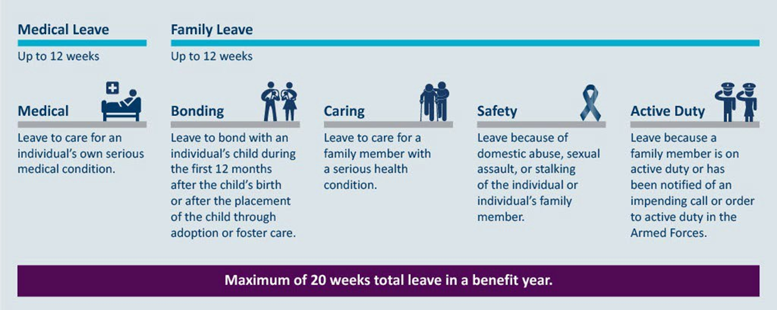
Qualifying PFML uses
DEED will determine the total time that the employee receives benefits; the employer’s responsibility is to honor the leave time that is approved.

Slide 13
Family member definition
The MPLL allows leave for spouses, children and parents, as well as:
Domestic partners and their children, as well as stepchildren;
The legal guardian of an employee;
Siblings;
Grandchildren, grandparents, and a spouse’s grandparents;
Sons- and daughters-in-law;
Children for whom the employee essentially acts as a parent, for whom the employee is a legal guardian, or form whom the employee is “de facto custodian”; and
“An individual who has a personal relationship” with the employee “that creates an expectation and reliance” that the employee will care for that individual without compensation, whether or not the employee lives with the individual.

Slide 14

What is a “serious health condition”?
Hospitalization, hospice care, or time in a residential medical care facility;
Continuing treatment or supervision by a health care provider that includes periods of incapacity of 7 or more days;
Treatment by a provider includes in-person and telehealth visits; or
Treatment includes exams to determine whether a serious health condition exists, and to evaluate that condition.

Slide 15

Employee Notice Requirements
If the need for leave is foreseeable, the employee must give the congregation at least 30 days’ advance notice
If the need for leave is not foreseeable, then notice must be as soon as practicable
Notice may be provided verbally or via phone or text.

Slide 16
Applications and Certifications for Leaves

Slide 17
The Process
Employee provides notice of the need for leave to employer in writing (could be email, text, or other writing) or by telephone
Employee then begins application process either on DEED website or through insurance company that is providing an equivalent plan

Slide 18
The Process
Employee will provide DEED or insurance company with information about basis for leave
DEED or insurance company will provide certification forms for providers to confirm need for leave
Type of certification required will depend on the basis for the leave
DEED or insurance company will inform employer whether application has been approved, along with approved dates and paid leave benefit

Slide 19

Certifications: Medical
Certification issued by a “Medical Provider.”
Certification forms will be coming from DEED.
Medical provider may be a doctor, a CNP or PA, a therapist or counselor, or other treating providers

Slide 20



Certifications: Family Leave
Employee must attest to their relationship with “family member”
Health care provider must certify relationship, leave schedule, and facts establishing need for care
If more than one employee seeks leave to provide care for the same family member, they must submit certifications from the same health care provider

Slide 21

Certification: Safety Leave
Certification of need for safety leave may come from:
A mental health professional or practitioner;
A licensed health care professional;
A domestic abuse advocate or sexual assault counselor;
A victim’s advocate employed by/under contract with/appointed by a Court;
A judge or referee, court administrator, prosecutor, or probation officer;
A Title IX coordinator;
A peace officer (full or part-time) or reserve officer; or
Or any other person who is capable of providing the information required by the statute.
Each of the above must be acting in their professional capacity.

Slide 22
Intermittent Leaves
Subject to the same certification requirements as full-time benefits
Request for leave must include a proposed schedule
Benefits will be calculated pro-rata by the hour (i.e., DEED will calculate an hourly rate – called the “hourly replacement” – and multiply that by the number of hours used during intermittent leave)
Employers may require employees who take 480 hours of intermittent leave in a benefit year to move to continuous leave

Slide 23
Managing Leaves

Slide 24
Employer Obligations
Provide information to DEED as requested (confirming employee’s wages, that employer received notice, etc.)
Honor the leave time approved by DEED or insurance company
Return the employee to the same or equivalent job at the end of the leave
If congregation has more than 15 employees, consider ADA obligations at end of paid leave period

Slide 25
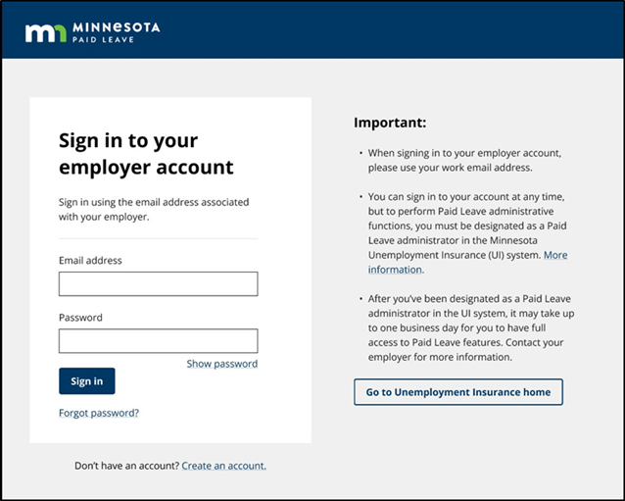
Managing Leaves: DEED Employer Accounts
Employers will set up an account on the Paid Leave Employer Portal with DEED
Employers will use this account to review applications for leave, leave determinations and more
Employers will be required to designate a paid leave administrator with portal access who is the point of contact between DEED and the employer

Slide 26
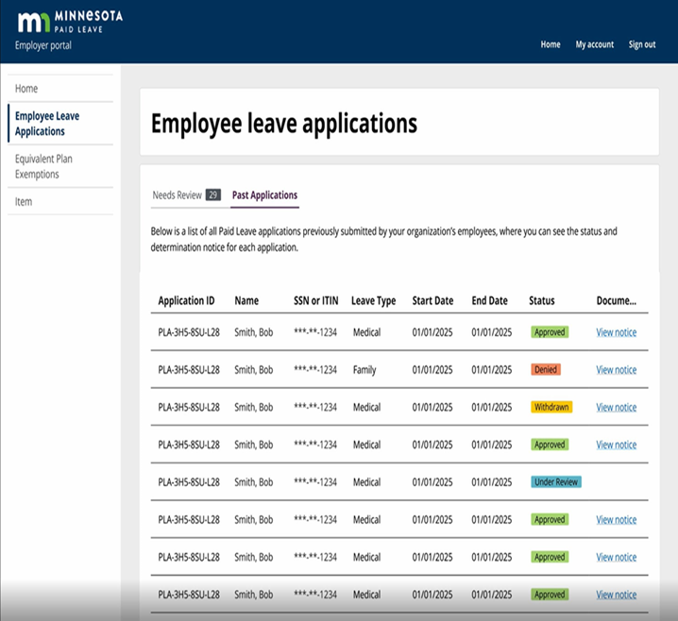
Tracking Employee Leaves
Employers will be able to track the status of each leave application, and view notices from DEED’s Paid Leave Division.

Slide 27

Appeals
An employee may appeal the denial of benefits through DEED
Appeals of DEED leave decisions are then heard by the Minnesota Court of Appeals

Slide 28
Employee Rights
Primary right: Job protection upon return, provided they return at the end of the designated available leave time
No interference with leave (i.e., employer must give the employee time off as determined under PFML rules)
No retaliation for taking leave
If an employee exhausts PFML and still can’t return to work, employers with more than 15 employees must consider disability/ADA concerns and determine whether leave should continue, unpaid

Slide 29
Employee Rights, continued
Continuation of group benefits, with employee continuing to pay their share of premiums
Upon return, benefits to be resumed “in the same manner and at the same levels as provided when the leave began”
Leave time not to be treated as or counted toward a break in service for purposes of vesting or ability to participate in a pension or retirement plan

Slide 30
Relation to other laws
Landscape of leave laws is now even more complex:
FMLA (employers with 50 or more employees)
ADA (employers with 15 or more employees)
Workers Compensation
Minnesota Parenting Leave
Private short-term disability
Pregnancy disability requirements
PFML
Consider all of these potential leave factors, and call if you are concerned about satisfying the rules of all statutes

Slide 31
Policy Decisions

Slide 32
Public vs. Private Plan
Primarily a budget consideration
Private insurance may provide more robust administrative services and relieve pastors or congregation leaders from having to administer the program

Slide 33
Cost split with employees?
For employers with more than 30 employees (whose tax rate is .88%), employer may split up to ½ of the cost with employees, capped at .44%
For employers with 30 or fewer employees (whose tax rate is .66%), employer may charge up to .44% to employees
Employee contributions taken through payroll deduction, as with health or other insurance premiums

Slide 34
Leave Policies
Whether to supplement benefits provided under state law?
Employees will only be paid a percentage of their total wage, capped at “average weekly wage” of $1,372 per week, under the new law
Congregations that currently provide some paid leave, or who want to offer benefits over and above that provided by the state, may supplement state benefit up to amount of employee’s total wages (but no more)

Slide 35
Leave Policies
Ability to supplement some or all types of PFML under state law
Subject to normal non-discrimination rules
Consider consistency with other policies of the congregation
Consider employee morale implications of supplementing some types of leave but not others
No obligation to supplement beyond PFML benefits

Slide 36
PTO, ESST, & Other Leaves
Employers may not require employees to use PTO, earned sick and safe time (ESST), or another form of paid leave before being able to use MN paid leave.
Employers may offer PTO, ESST, etc. as a supplemental, optional benefit for the employee to "top off" their weekly Paid Leave benefit to receive 100% of their weekly pay.
Employees have the right to use PTO, ESST, and other forms of paid leave before applying for Minnesota Paid Leave benefits

Slide 37
Preparing for 2026

Slide 38
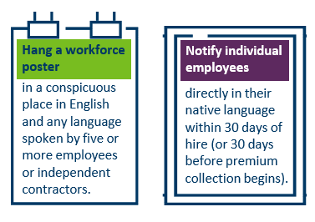
Employer Notice Requirements
By December 1, 2025 employers must:

Slide 39
Required Paid Leave poster available on DEED website

Slide 40
Questions?

