Slide 1


MINNESOTA PAID LEAVE WEBINAR
Minneapolis Area Synod of the ELCA
September 11, 2025

Slide 2

AGENDA
Eligibility
Benefits
Employer Responsibilities
Other Information
Questions

Slide 3
MINNESOTA PAID LEAVE
ELIGIBILITY

Slide 4
COVERED EMPLOYEE
Employee who worked 50% or more of the prior year in Minnesota, or for employees who did not work 50% or more of the year in any one state, live in Minnesota
Employee must have earned at least 5.3% of the statewide average annual wage in the past year ($3,900 in 2025)
Employee receiving payments from unemployment insurance, workers compensation, Social Security disability during an absence not eligible
Remote worker who earned at least $3,900 and works at least 50% of the time from a location in Minnesota is covered

Slide 5
OTHER WORKERS
Workers not covered who can opt into Paid Leave:
  Independent contractors
  Self-employed workers
  Tribal nations
Workers not covered who CANNOT opt into Paid Leave:
  Federal government employees
  Exempt seasonal hospitality employees
  Railroad employees

Slide 6
MINNESOTA PAID LEAVE
BENEFITS

Slide 7
PARTIAL WAGE REPLACEMENT
  Up to 12 weeks of paid MEDICAL leave
  Up to 12 weeks of paid FAMILY leave
  No more than 20 weeks of Paid Leave in a benefit year
  Paid Leave may be taken intermittently
  Amount of Paid Leave:
Weekly Wage | % of Weekly Wage Received
Up to $711.50 | 90%
Between $711.50 - $1,423 | 66%
Above $1,423 | 55%

Slide 8
JOB PROTECTION
When returning from leave, employees must be restored to the same or an equivalent position with the same pay and benefits as before leave
Job protection begins 90 days from an employee’s date of hire

Slide 9
MINNESOTA PAID LEAVE
EMPLOYER RESPONSIBILITIES

Slide 10
REPORTING AND PREMIUM PAYMENTS
  Ensure your organization is reporting wages as required through the unemployment insurance (UI) reporting system
  Decide whether to participate in the state Paid Leave program or have a state-approved self-insured plan or insurance-provided plan offering the same or better benefits than Paid Leave
  Determine if your organization is going to split premiums and if applicable, start deducting premiums from employee paychecks beginning January 1, 2026

Slide 11
PAID LEAVE PREMIUMS
  Submit quarterly Paid Leave premiums through the state’s UI system. First quarterly premium will be based on wages reported between January 1, 2026 and March 31, 2026 and is due by APRIL 30, 2026
  2026 premium = .88% of employee’s wages up to Social Security cap ($176,100 in 2025)
  Employers must pay at least 50% (.44%) and can deduct the remainder (.44%) from an employee’s pay beginning January 1, 2026
  Small employers pay reduced premium of .22%; employee portion of .44% is not reduced

Slide 12
LEAVE ADMINISTRATION
  Establish clear notification process for employees to notify the organization they are applying for Paid Leave
  Coordinate Paid Leave with the organization’s paid time off benefits; decide whether to permit supplemental payments to “top off” Paid Leave payments (so employees can have 100% of wages replaced)
  Establish intermittent leave policy
  Designate Paid Leave administrator(s)

Slide 13
REQUIRED NOTICES
  By December 1, 2025:
  Inform all employees about Paid Leave rights and benefits in their primary language in a written notice; retain acknowledgment
  Inform new employees of Paid Leave rights and benefits within 30 days of hire
  Display workplace poster in English and in any language spoken by 5 or more employees
  Model poster and notifications on Paid Leave website

Slide 14
MINNESOTA PAID LEAVE
OTHER INFORMATION

Slide 15
SMALL EMPLOYER ASSISTANCE
Small employer = employs 30 or fewer employees that make an average weekly wage of less than 150% of statewide average weekly wage ($2,134.50 in 2025)
Grants of up to $6,000 available beginning January 1, 2026 to help offset the cost of hiring temporary workers or increase current employees’ wages to cover for employees on Paid Leave

Slide 16
INTERACTION WITH OTHER LAWS
How Paid Leave interacts with:
Minnesota Earned Sick and Safe Time (ESST)
Minnesota Parental Leave
Federal Family and Medical Leave (FMLA)

Slide 17
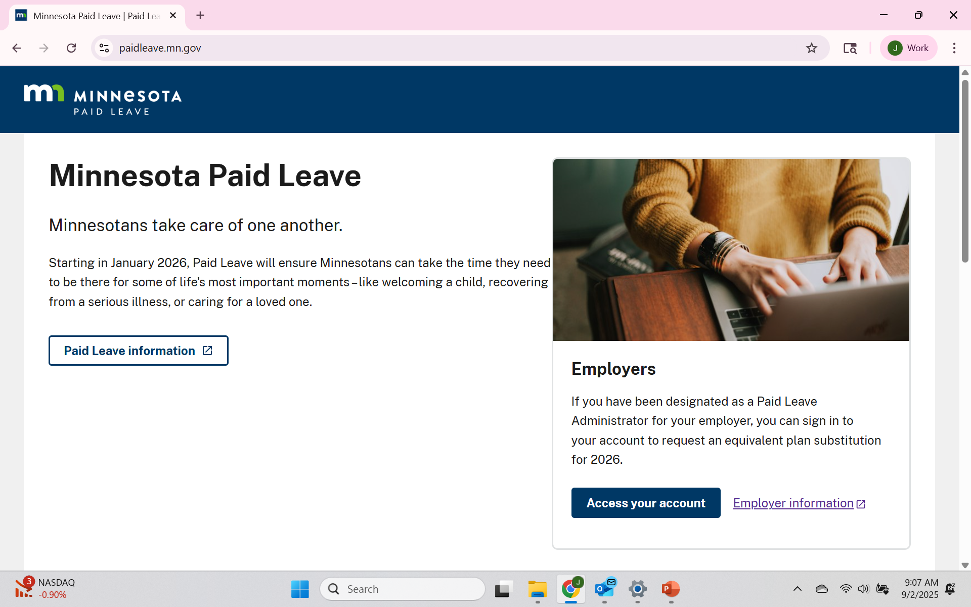
PAID LEAVE RESOURCES
Minnesota Paid Leave website: https://paidleave.mn.gov/

Slide 18
QUESTIONS??

Slide 19
THANK YOU!
jewelie@jgrapelaw.com
651.633.1717

