Slide 1
Information Session
Thriving Congregations

Slide 2
Overview:
Introductions
Overview and Collaboration
Augsburg University - Riverside Innovation Hub
Minneapolis Area Synod - Faith Practices and Neighboring Practices
Application Timeline
More Info & Links
Q/A
Notes:
K

Slide 3
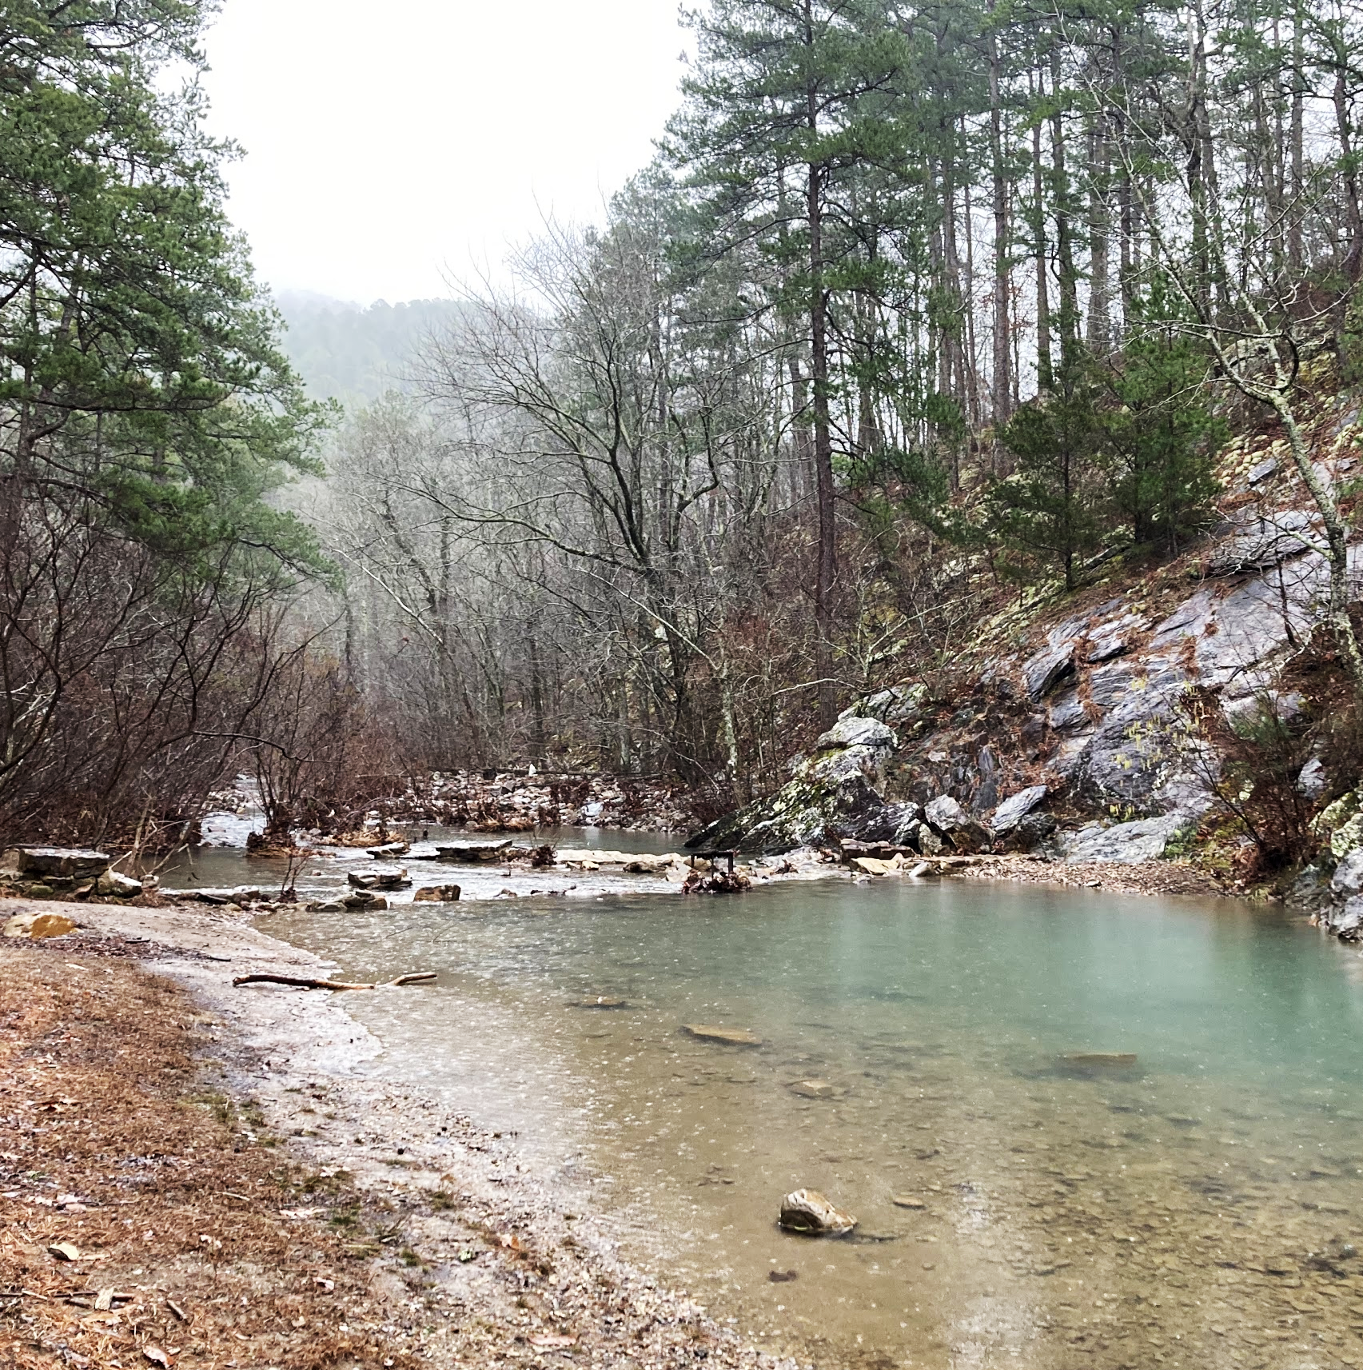
Introductions
Share in the chat:
Your Name, Pronouns
Congregation
What intrigues you about this opportunity?
What do you want to learn during this workshop?

Slide 4
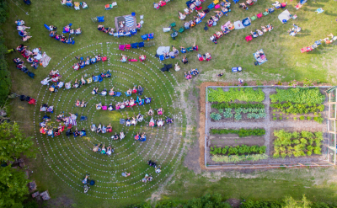
Overview and Collaboration
Funded by Lilly Endowment’s Thriving Congregations Initiative
Two distinct learning communities, two cycles
Shared touch points over 5 years
Shared application process
Resource each others’ learning
Shared Learning Summit
Notes:
K

Slide 5
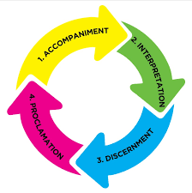
Riverside Innovation Hub - Augsburg University
Focus: Place based vocational discernment in the public square for the common good through the Public Church Framework
Three cohorts of four congregations (12 total) facilitated by RIH staff.
Monthly meetings rotating between:
large group learnings events
cohort meetings and
congregational team meetings
Open to all Christian congregations within an
hour of the Twin Cities Metro Area. Congregations
outside this geographic area may apply but the
experiences may differ.
Congregational fee of $1000 over two years.
Notes:
JM

Slide 6
Faith Practices and Neighboring Practices - Minneapolis Area Synod
Focus: Faith Practices and Neighboring Practices
Three cohorts of five congregations (15 total)
Coaching for Community Organizing and Spiritual Practices
Cohort groups will immediately teach their congregational leaders
Monthly meetings and four retreats
Eligibility: Open to congregations in the
boundaries of the MAS and AME
congregations within MN
Notes:
JH

Slide 7
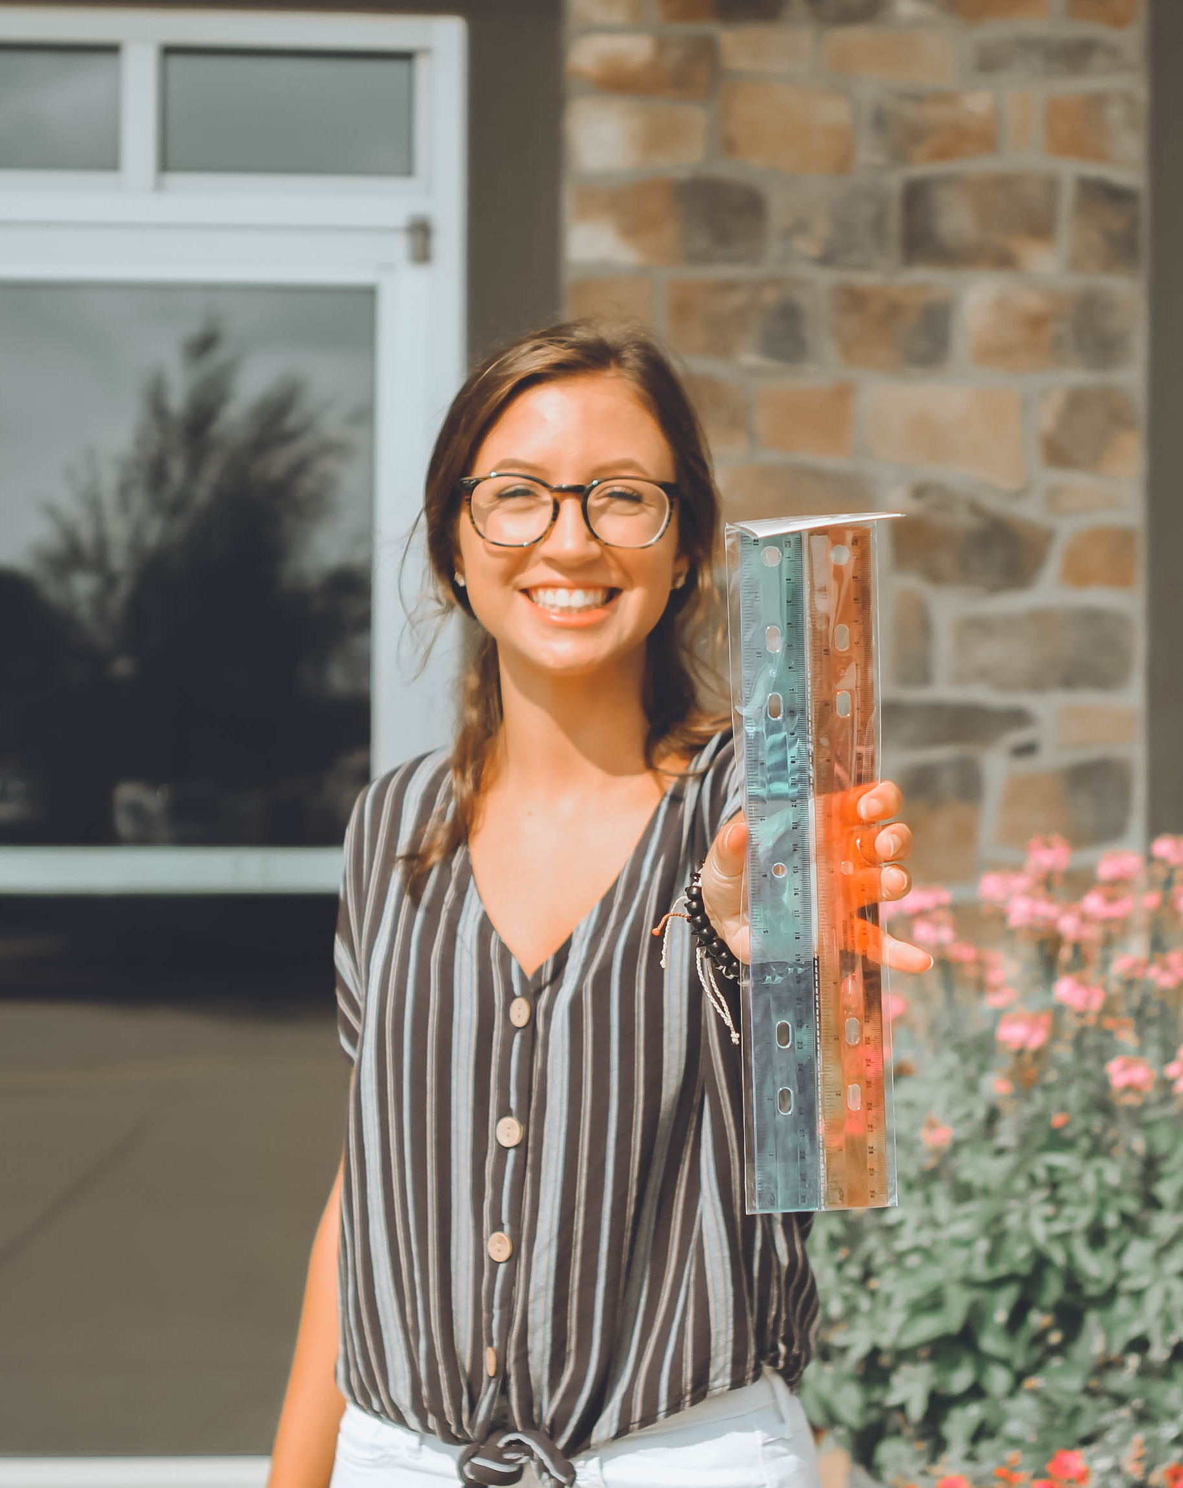
Rosa and St. Peter’s Lutheran Church
St. Peter’s Pastor Clay invites Rosa to join a working group so they can fill out an application for the synod’s new initiative, Faith Practices and Neighboring Practices: Renewing Congregational Imagination.
Rosa learns that congregations accepted for this opportunity will send five people to learn faith and neighboring practices for two years. St. Peter’s would be one of four other congregations selected to be in a cohort group. St. Peter’s would be placed in a group based on either their like-size, like mission, or like-geography. Pastor Clay was pleased to hear that the Minneapolis Area Synod also asked a neighboring AME congregation to apply as well.

Slide 8
Rosa and St. Peter’s Lutheran Church cont…
The people from St. Peter’s would commit to meeting twelve times a year for two years with their cohort group. Included in every group of five would be a Pastor, a teenager, and perhaps, a community member who does not necessarily worship at St. Peter’s, but who appreciates and is aligned with St. Peter’s ministry in the neighborhood. Rosa has been a member of the church for a few years and volunteers regularly, but this kind of leadership role will be new and she is glad a former congregational president is a part of the group too. She was surprised to hear that St. Peter’s would have to leave the cohort if more than one person drops out. She thought that made this sound very serious. For eight of the monthly cohort meetings in each year, they would meet for two hours with their synod-hired coach. These meetings would focus on learning faith and neighboring practices. The meetings would have guest experts in spiritual direction and faith formation. The cohort groups would also participate in the programming provided by the Center for Leadership and Neighborhood Engagement (CLNE) in North Minneapolis. Together they would be given tools to deepen their faith journey, strategies for listening to their neighbors, and effective ways to engage in their neighborhood. Funds would be provided for some meetings so the cohort group could not only share a meal from a locally-owned restaurant, but also hear from the neighborhood restaurant owner and staff. All through these meetings, besides being mentored by their coach and hearing from experts, the cohort groups would also be learning from each other how best to do these practices in their context.

Slide 9
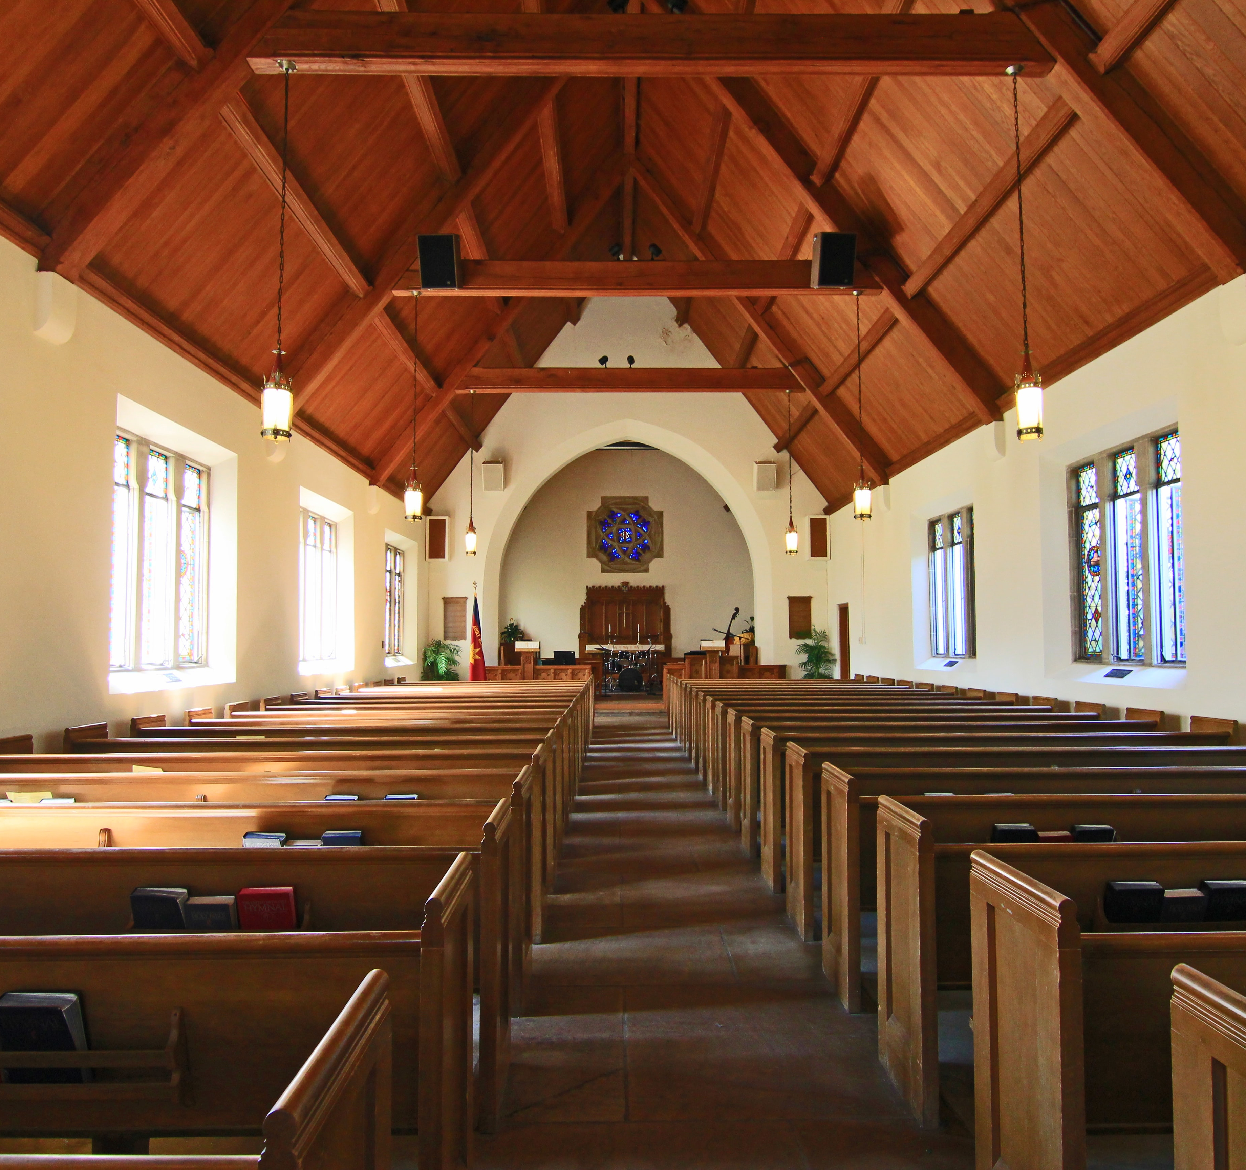
Rosa and St. Peter’s Lutheran Church cont…
Another expectation of the cohort group intrigued Rosa. All the cohort groups would take a learning from one month, and turn around and coach and teach their church council the next week or week after. Clearly, these cohort groups were more than just for learning, they were for practicing. Rosa knew from teaching Sunday School that one of the best ways to learn a practice was to teach it to others.
Each year, four of the monthly meetings would be longer than the two-hour meetings. The first of these four meetings would be an overnight retreat with the other three synod cohort groups. This longer time together would help all the participants to meet, as well as to learn a common language around faith and neighboring practices—with large group time and individual cohort time. Rosa saw the value in the longer meeting times—plus, this would be a critical opportunity for synod’s coach and leadership team to listen carefully to the concerns of the participants from St. Peter’s and the other congregations.

Slide 10
Rosa and St. Peter’s Lutheran Church cont…
As Rosa learned more, she was glad Pr. Clay had asked her to participate with a small group working to complete the congregation’s application. Of course, she would like to represent St. Peter’s in its cohort group, but the four longer meetings would be a hardship for her. Rosa confided in Pr. Clay her willingness, but she could not afford to be away from her two jobs and her growing family for day-long meetings and an overnight retreats. Pr. Clay asked her not to worry. If St. Peter’s is accepted into the cohort group, Rosa would be eligible for honorariums to cover day care and lost wages. Rosa was thrilled to hear that money was set aside in the grant to make it possible for her to participate.
The two years of meeting in a cohort would conclude with a summit hosted by the synod and the Christensen Center for Vocation (CCV) at Augsburg University. Led by cohort members, and staff from the synod, CLNE, and CCV, congregational leaders from the region would be invited for the day to hear tried and tested faith practices and neighboring practices.
Rosa, Pr. Clay, and the working group submitted their application and awaited word. They knew to be ready for the initial focus group interview if their beloved St. Peter’s was selected.

Slide 11
Application Process
Step 1: Attend an Information Session (you are here!)
Step 2: Submit a Letter of Intent
Have your Senior Pastor submit a letter of intent to apply, via a
google form.
Step 3: Submit an Application
A joint application includes a “Primary Application” and supplemental sections for each project, submit via a google form by April 15th.
Step 4: Invitation Process
RIH and MAS will review applications. Twelve RIH and fifteen MAS congregations will be sent invitations on May 15th.
Notes:
A

Slide 12
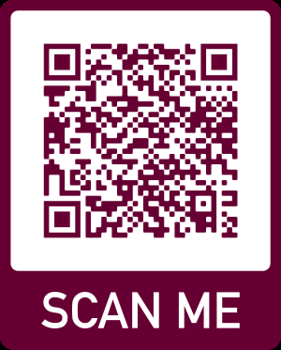
To Learn More...
Application Webpage
Links to handouts (MAS/RIH Joint Summary & RIH overview)
All forms (Letter of Intent & Application)
Upcoming Info Session RSVP Information
Contact Nicholas Tangen Email: n.tangen@mpls-synod.org Cell: 651-808-7067
MAS Website
RIH Website
Notes:
Link to application process and handouts: https://www.augsburg.edu/ccv/2021/01/29/thriving-congregations-learning-partnership-application-process/
Link PDF for 2 page summary and RIH full description share in chat
What is on the webpage:
2 PDFs (2 project summary, RIH overview)
All links to forms needed to apply
Letter of Intent
Application (with pdf version)
Info Session RSVPs (upcoming)

Slide 13
Q/A
Notes:
All

