Slide 1
Engaging Racial Justice through the Church Body
Brenda Blackhawk
Minneapolis Area Synod, ELCA

Slide 2
Macro-Level
Branches: Upper-most part; reach upwards; many in number; helps to feed the tree.
Structural/systemic racism
There are people that directly benefit from the culture and structures of racism.
The tree creates an environment that animals rely on and benefit from.
Meso-Level
Trunk: The thickest part of the tree; holds up the branches.
Cultural/societal racism
Historical trauma; Internalized Racial Oppression
Micro-Level
Roots: They go deep; helps to feed the tree; mostly hidden from plain view

Slide 3
Minneapolis Area Synod, ELCA

Slide 4
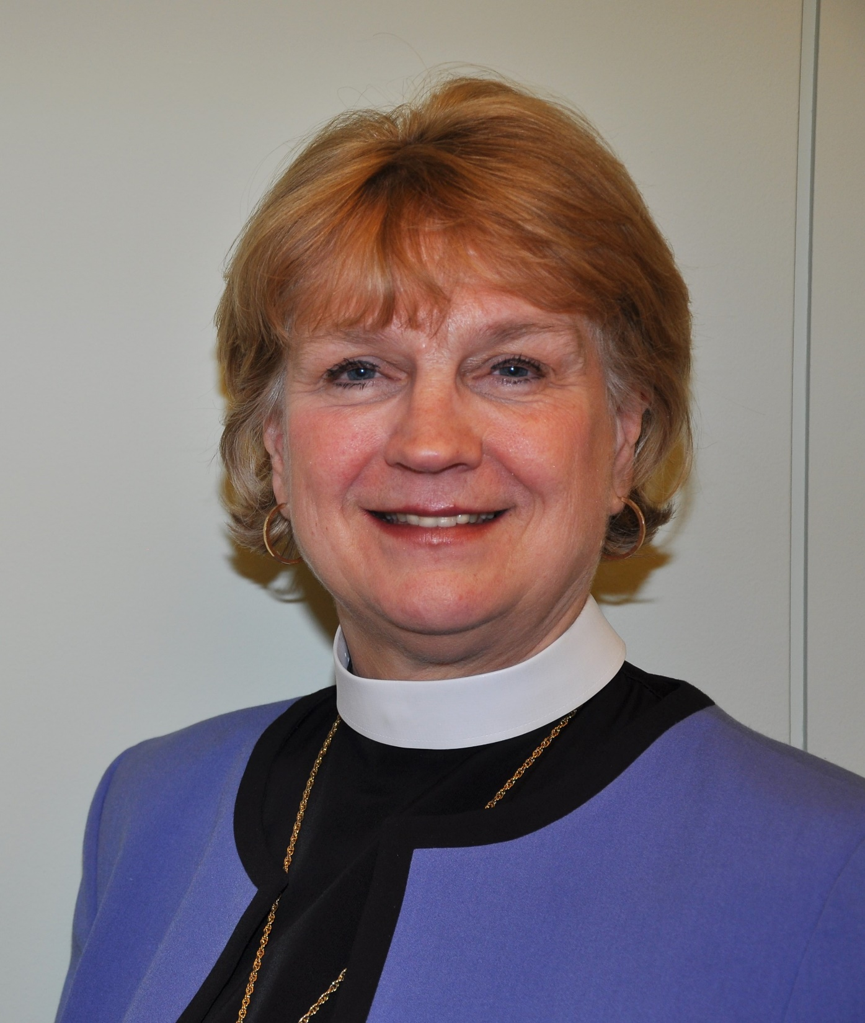
Minneapolis Area Synod, ELCA
The largest of the 65 synods in the United States
145 Congregations
More than 160,000 baptized members
Over 300 active rostered leaders
Over 2,000 students confirmed each year
“The Minneapolis Area Synod works together so that all experience gracious invitation into life-giving Christian community and live in just and healthy neighborhoods.”
Bishop: Rev. Ann Svennungsen

Slide 5
Minneapolis Area Synod, ELCA
Racial Justice Programming

Slide 6
Racial Justice Programming
Defined: Specific programming run through or with the Minneapolis Area Synod to advance Racial Justice and serve our congregations and communities.
Synod Level
Unite Table
Mission Table
Leaders of Color
Congregational Level
Congregational Racial Justice Liaisons & Teams
In Partnership
AMMPARO
Muslim Solidarity Task Force
Truth and Reparations

Slide 7
Minneapolis Area Synod, ELCA
Racial Justice Programming
Mission Table

Slide 8
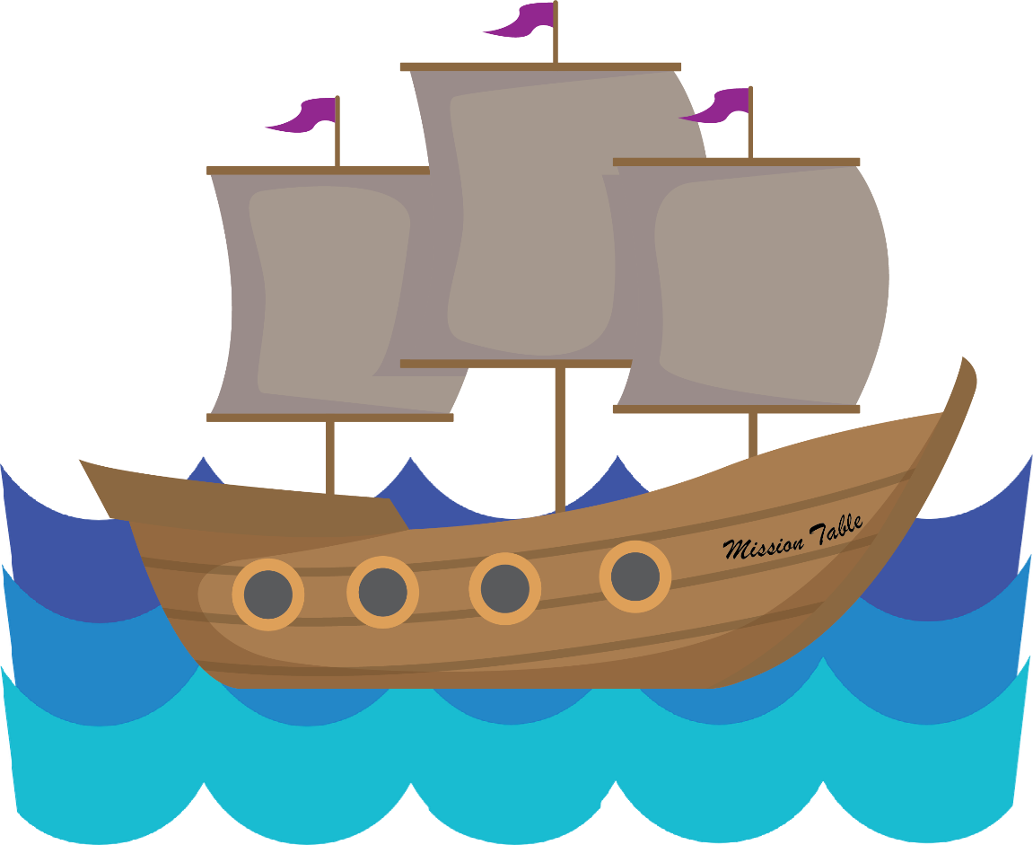
Mission Table
Purpose: Reaching new people in new places in new ways
Run through/with the Director of Evangelical Mission
Help new start churches
Serve multi-cultural ministries

Slide 9
Minneapolis Area Synod, ELCA
Racial Justice Programming
Unite Table
Mission Table

Slide 10
Unite Table
Resource and connect different groups of leaders doing anti-racist work in the synod
IDI and training – provide to congregations in our synod
Liaison gatherings – resource sharing
Work with staff, council, and candidacy committee
Help congregations write racial justice statements

Slide 11
Minneapolis Area Synod, ELCA
Racial Justice Programming
Unite Table
Mission Table
Racial Justice Liaisons/Teams

Slide 12
2016 Resolution Addressing Racial Injustice
Passed at the 2016 Minneapolis Area Synod Assembly
“the 2016 Minneapolis Area Synod Assembly ask the Unite Table to provide resources to congregations regarding racial justice”
“the bishop of the Minneapolis Area Synod encourage congregations of the synod to have discussions toward creating racial justice statements that reflect their contexts…”
“that each congregation be strongly urged to find ways to advocate for racial justice”
“that each congregation be asked to forward the name of a congregational racial justice liaison to the Unite Table of the synod by December 31, 2016”

Slide 13
Racial Justice Liaisons and Teams
Conduit of information between the congregation and the synod
Learn about racism and white privilege
Write racial justice statement
Grow the racial justice team in the congregation
Dismantle white supremacy in our church
Take the IDI and work individual and group plans
Action and advocacy – participate in protests and educate the congregation
Provide new ways for congregation to engage, learn, and grow together

Slide 14
Minneapolis Area Synod, ELCA
Racial Justice Programming
Unite Table
Mission Table
Leaders of Color
Racial Justice Liaisons/Teams

Slide 15
Leaders of Color
A group for Leaders of Color ONLY
Goals:
To create a safe space and “brave” space – a space to heal
To “darken the ELCA”
To share stories and experiences esp. seminary
To support the upcoming leaders of color
To help find solutions and share opportunities
To assist the synod to do and be better

Slide 16
Minneapolis Area Synod, ELCA
Racial Justice Programming
Unite Table
Mission Table
Leaders of Color
Racial Justice Liaisons/Teams
AMMPARO

Slide 17
AMMPARO
The Spanish word amparo refers to the protection of a living creature from suffering or damage.
AMMPARO stands for (Accompany Migrant Minors with Protection, Advocacy, Representation, and Opportunities)
AMMPARO’s main goal is the awakening, engaging, and equipping of Lutherans in their baptismal calling to be in solidarity with oppressed immigrants.
Guardian Angels is a national AMMPARO program through which individuals volunteer to serve as observers in juvenile immigration court and help connect minors with needed services.
Notes:
The Joint Saint Paul Area and Minneapolis Area Synod AMMPARO Leadership Team works especially in the following areas:
Education – provide educational opportunities and resources for congregations, committees, and individuals
Advocacy – Increase Lutheran support of immigrant-led campaigns
Partnership – promote partnership between immigrant and anglo congregations and connections with other groups supporting immigrants
Guardian Angels – provide court observation of juveniles in immigration proceedings

Slide 18
Minneapolis Area Synod, ELCA
Racial Justice Programming
Unite Table
Mission Table
Leaders of Color
Racial Justice Liaisons/Teams
AMMPARO
Muslim Solidarity Task Force

Slide 19
Muslim Solidarity Task Force
Supporting Minneapolis Area Lutherans in our 2017 resolution to learn, build relationships and take action for peace, with and on behalf of our Muslim neighbors.
The resolution established a Muslim Solidarity Task Force that has hosted trainings for synod congregations to engage with their Muslim neighbors.

Slide 20
Minneapolis Area Synod, ELCA
Racial Justice Programming
Unite Table
Mission Table
Leaders of Color
Racial Justice Liaisons/Teams
AMMPARO
Truth & Healing
Muslim Solidarity Task Force

Slide 21
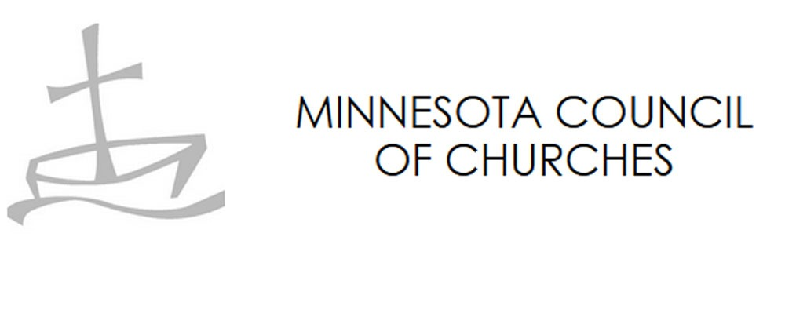
Truth and Reparations
The Minneapolis Area Synod, a member judicatory of the Minnesota Council of Churches (MCC), is partnering with the Council to embark on an ambitious initiative for truth telling, education, and reparations.
Truth & Reparations is an ambitious 10-year project approved by the MCC Board in October of 2020.
The vision includes Truth and Reconciliation commissions, Diversity, Equity and Inclusion trainings in congregations, and reparations to BIPOC communities for the harm down by white supremacy in Minnesota.

Slide 22
Minneapolis Area Synod, ELCA
Racial Justice Programming
Racial Justice Organizing
Unite Table
Mission Table
Leaders of Color
Racial Justice Liaisons/Teams
AMMPARO
MCC Reparations Work
Muslim Solidarity Task Force

Slide 23
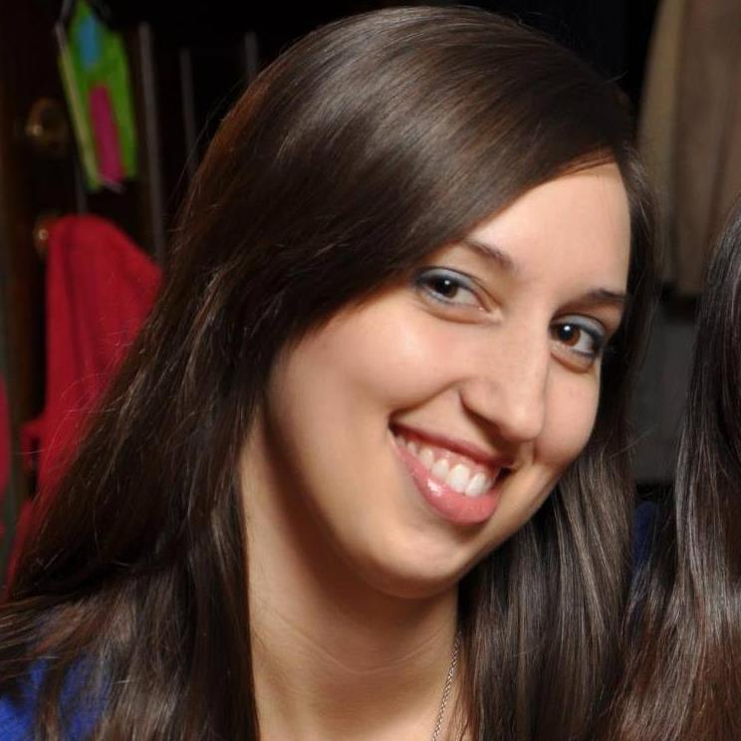
Racial Justice Organizing
Use community organizing skills and tools to create real change in people’s lives
Congregational Organizer for Racial Justice: Brenda Blackhawk
Use the groups already in existence
Create an organizing team with synod leaders
Give congregations a practical way to engage on specific racial justice issues
Support congregations doing organizing on racial justice issues

Slide 24
Minneapolis Area Synod, ELCA
Racial Justice Programming
Racial Justice Organizing
Unite Table
Mission Table
Leaders of Color
Racial Justice Liaisons/Teams
AMMPARO
SOAR
MCC Reparations Work
Muslim Solidarity Task Force
Voter
Re-enfranchisement

Slide 25
Strategic Organizing Against Racism (SOAR)
Direct action organizing – engaging lawmakers, elected officials, etc.
Community organizing and community action with Lutherans
To energize Lutherans to take action
Choose an issue to build a campaign around
Build connections amongst other organizations doing powerful work
WIN!

Slide 26
Minneapolis Area Synod, ELCA
Racial Justice Programming
Racial Justice Organizing
Unite Table
Mission Table
Leaders of Color
NEED
Racial Justice Liaisons/Teams
AMMPARO
SOAR
MCC Reparations Work
Muslim Solidarity Task Force
Voter
Re-enfranchisement

Slide 27
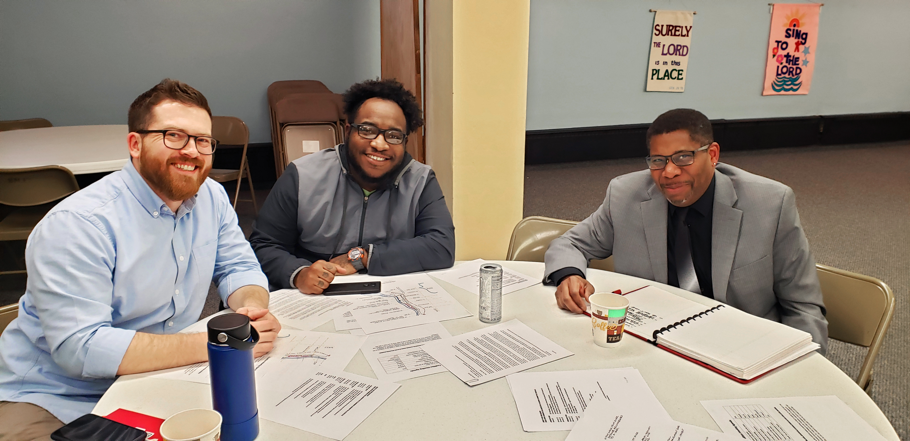
NEED (Northsiders for Equitable Engagement & Development)
An ecumenical coalition in North Minneapolis
Works to prevent gentrification that leads to displacement

Slide 28
Minneapolis Area Synod, ELCA
Racial Justice Programming
Racial Justice Organizing
Racial Justice Development
Unite Table
Mission Table
Leaders of Color
NEED
Racial Justice Liaisons/Teams
AMMPARO
SOAR
Resource Development & Sharing
MCC Reparations Work
Muslim Solidarity Task Force
Voter
Re-enfranchisement

Slide 29
Racial Justice Development
Our synod works hard to ensure that our staff, our congregations, and our neighbors have the opportunity to grow and develop, especially when it comes to cultural competency and racial equity.
We have many different tools and resources to support that development.

Slide 30
Minneapolis Area Synod, ELCA
Racial Justice Programming
Racial Justice Organizing
Racial Justice Development
Unite Table
Mission Table
Leaders of Color
IDI
NEED
Racial Justice Liaisons/Teams
AMMPARO
SOAR
Resource Development & Sharing
MCC Reparations Work
Muslim Solidarity Task Force
Voter
Re-enfranchisement

Slide 31
IDI (Intercultural Development Inventory)
Used by a team of trained synod volunteers
This tool and the subsequent training is designed to develop and grow intercultural competence.
The assessment provides a baseline and starting point for this work and helps identify developmentally appropriate learning and interventions.

Slide 32
Minneapolis Area Synod, ELCA
Racial Justice Programming
Racial Justice Organizing
Racial Justice Development
Unite Table
Mission Table
Leaders of Color
IDI
CLNE
NEED
Racial Justice Liaisons/Teams
AMMPARO
SOAR
Resource Development & Sharing
MCC Reparations Work
Muslim Solidarity Task Force
Voter
Re-enfranchisement

Slide 33
CLNE (Center for Leadership & Neighborhood Engagement)
To offer transformative learning experiences that strengthen and inspire leaders and congregations.
The Center partners with community organizations to provide access to coaching, training, programming and immersion experiences that teach:
Cultural Competency
How to engage neighbors through asset-based community development

Slide 34
Racial Justice Organizer
SOAR
Structural/systemic racism
Macro-Level
Unite Table
Racial Justice Liaisons
Meso-Level
Cultural/societal racism
Tools: IDI, text studies, forums, etc.
Micro-Level
Historical trauma; Internalized Racial Oppression
Leaders of Color
Notes:
If the goal is remove all trace of the tree, then we need to simultaneously cut off the branches, chop the trunk, and pull up the roots. The synod is doing some work already in these areas, but we can always do more. We need to engage our congregations.
Leaders of Color
Unite Table
Racial Justice Liaisons
Tools
ME
My job is the “what now.” It is the action piece.

Slide 35
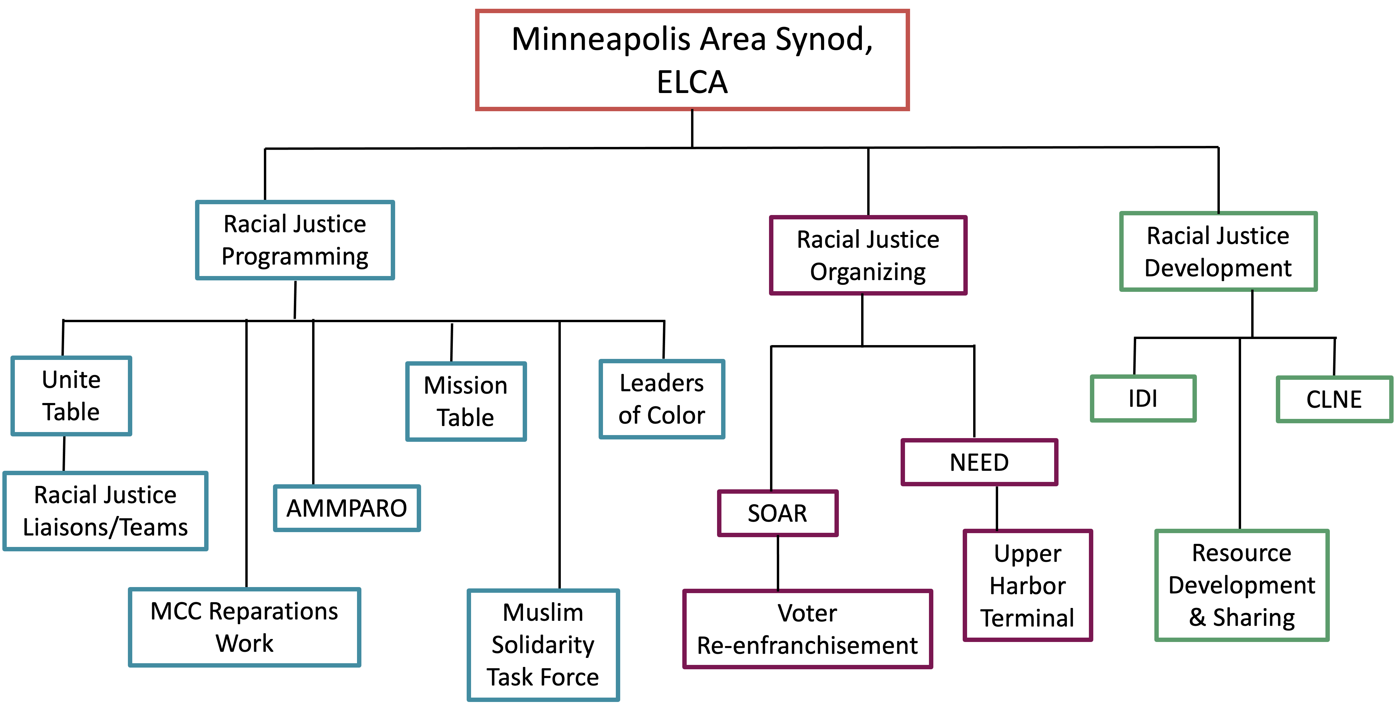
Where do you see yourself?

